Slide 1

Beyond Homophily in Graph Neural Networks: Current Limitations and Effective Designs
Jiong Zhu, Yujun Yan, Lingxiao Zhao, Mark Heimann, Leman Akoglu, Danai Koutra
NeurIPS 2020
Presenters:
Samidha Verma (2020CSY7575) and Sai Kandregula (2020CSY7570)

Slide 2

OUTLINE
Motivation
Key Contributions
Notations
Background
Key Designs
H₂GCN Framework Details
Related Work (Comparison of H₂GCN with other GNNs )
Experimental Setup and Evaluation
Ablation Study
Drawbacks
Forward Study
Conclusion

Slide 3
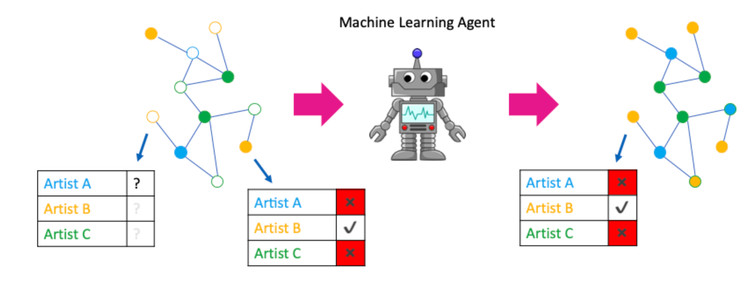
SEMI-SUPERVISED NODE CLASSIFICATION
GOAL:
Given a graph G(V,E) with adjacency matrix A, feature matrix X such that x_{v} is the feature of node v, and a few labelled nodes, predict the labels of remaining nodes.
Graph Neural Networks are widely used and effective approaches to solve this task
Most GNN architectures assume homophily in the graph structure.

Slide 4
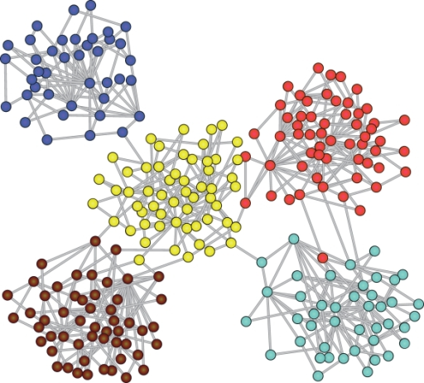
HOMOPHILY
“Birds of a feather flock together”
Examples:
Online Social Networks (Triads – friend of friend is generally friend)
Citation networks (Papers of similar research domain cite each other)
Image Source: https://github.com/benedekrozemberczki/awesome-community-detection

Slide 5
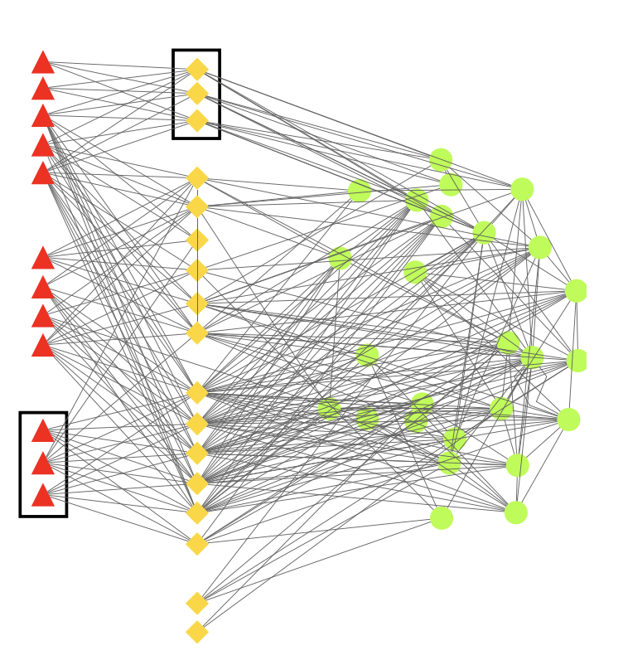
HETEROPHILY
Frauds
Accomplices
Honest Auctioneers
“Opposites Attract”
Examples:
Online Auction/E-commerce (Fraudsters-Accomplices)
Protein Structures (w.r.t. different amino acid types)
Heterophily
Auction Network
Image Source : http://www.cs.cmu.edu/~christos/PUBLICATIONS/pkdd06-fraud-old.pdf

Slide 6
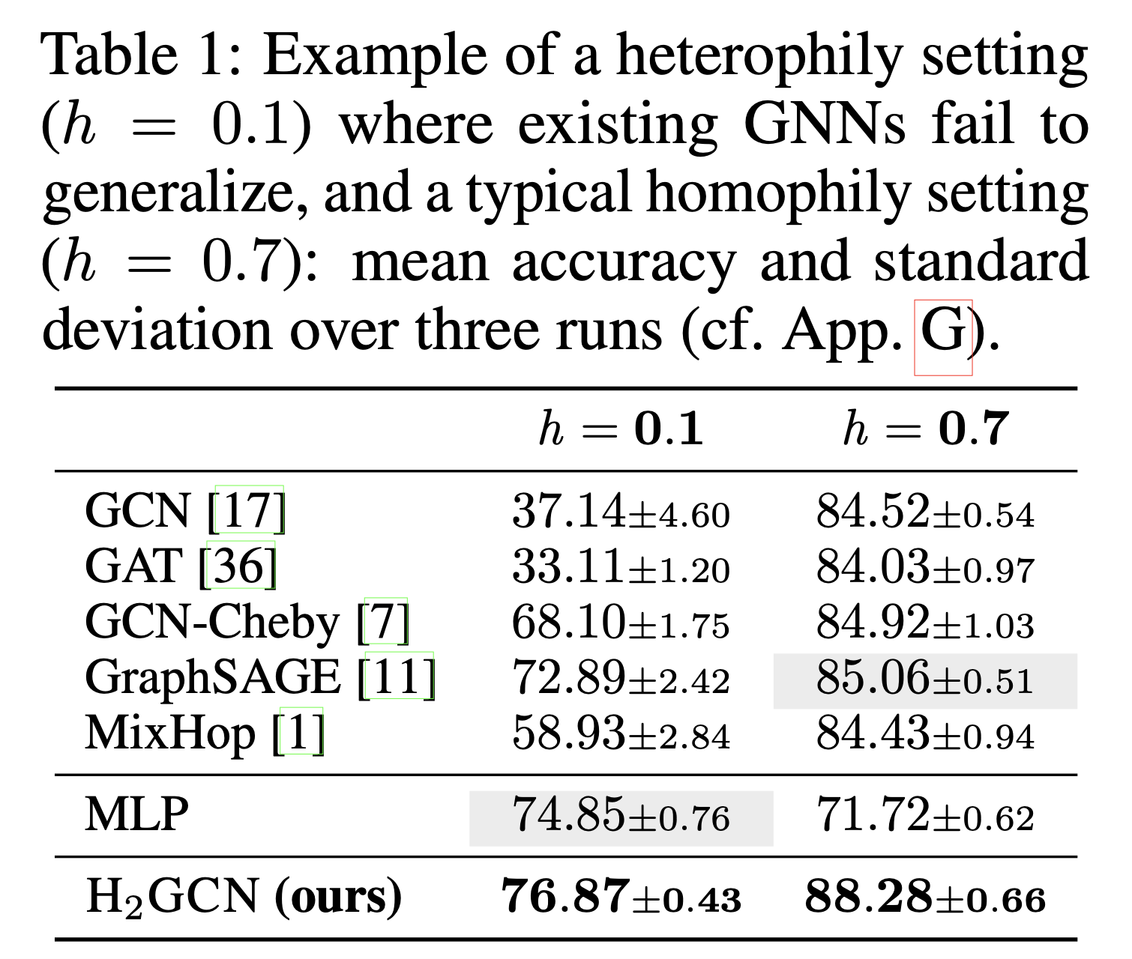
Limitations of GNNs in the case of Low Homophily or Heterophily
Results for semi-supervised node classification task on synthetic dataset syn-cora.

Slide 7
KEY CONTRIBUTIONS
Reveal current limitations of GNNs in case of heterophily.
Give key designs for heterophily and a new model.
Extensive empirical evaluation on synthetic and real world datasets.

Slide 8
KEY DESIGNS
Effective Design For Networks with Homophily
D1: ego- and neighbour-embedding separation
(GraphSAGE)
D2: higher-order neighbourhoods
(MixHop)
D3: combination of intermediate representations
(Jumping Knowledge Connections)
H₂GCN

Slide 9
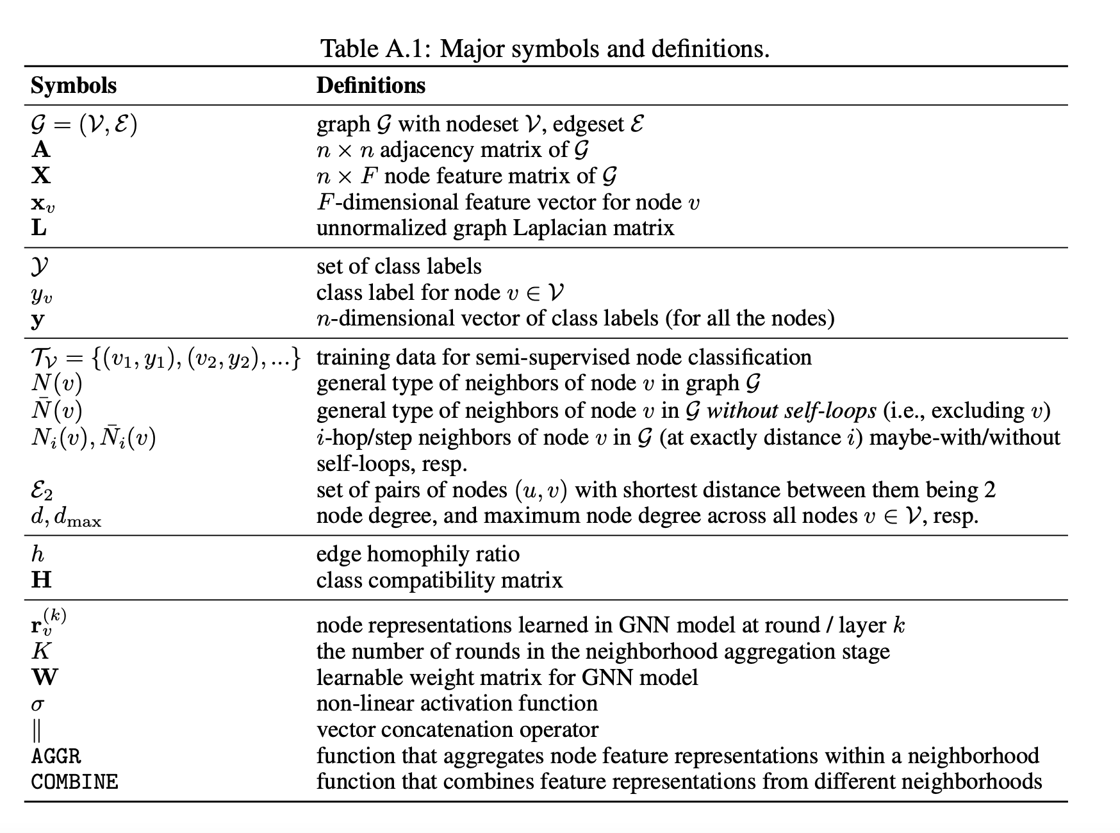
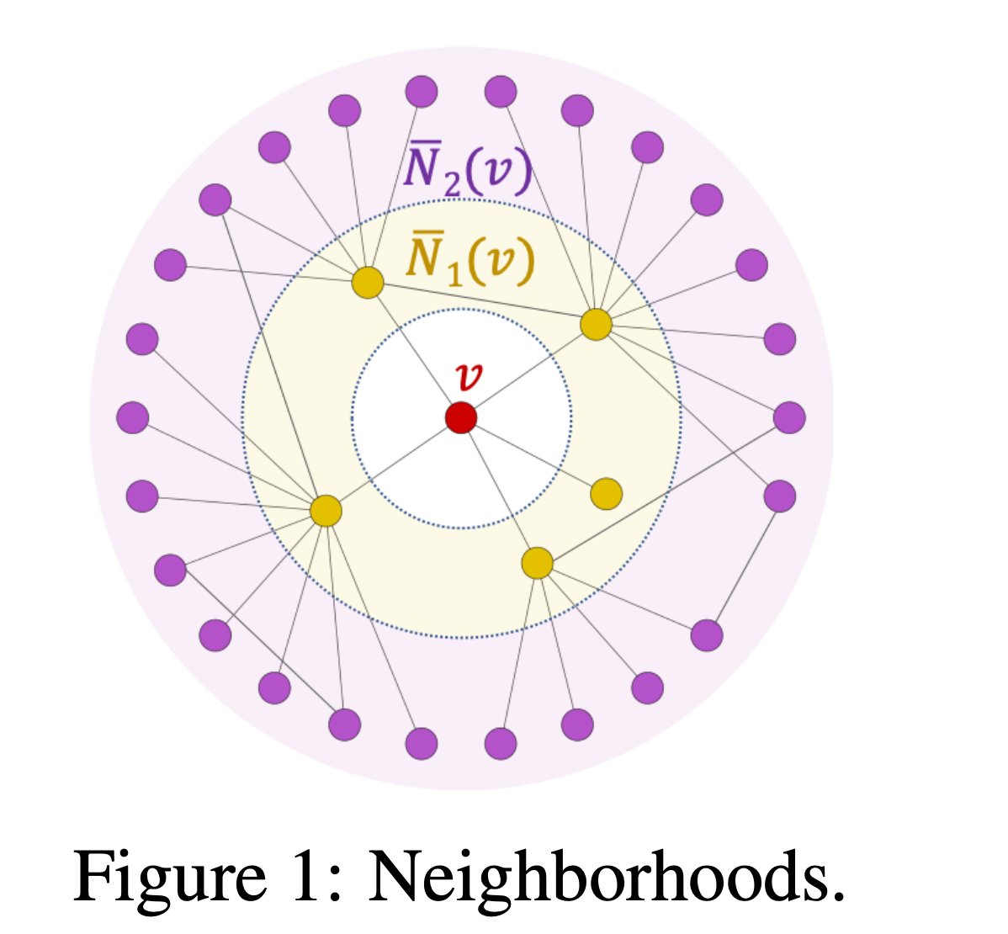
NOTATIONS

Slide 10
HOMOPHILY AND HETEROPHILY
Focus is on heterophily in class labels.
Definition 1
Edge homophily ratio, h=|{(u,v):(u,v)∈E∧y_{u}=y_{v}}|/|E|
Definition 2
Graphs with strong homophily : high edge homophily ratio, h→1
Graphs with strong heterophily (i.e., low/weak homophily) : small edge homophily ratio, h→0

Slide 11
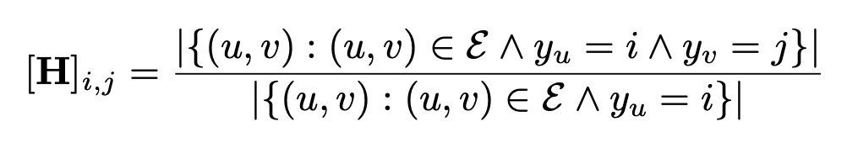
CLASS COMPATIBILITY MATRIX
The class compatibility matrix H has entries [H]_{i,j} that capture the fraction of outgoing edges from a node in class i to a node in class j:
Edge homophily ratio : Gives overall trend of edges in the graph
The actual level of homophily may vary within different pairs of node classes, i.e., there is different tendency of connection between each pair of classes.
Within the same network, some pairs of classes may exhibit homophily, while others may exhibit heterophily.

Slide 12
KEY DESIGNS

Slide 13
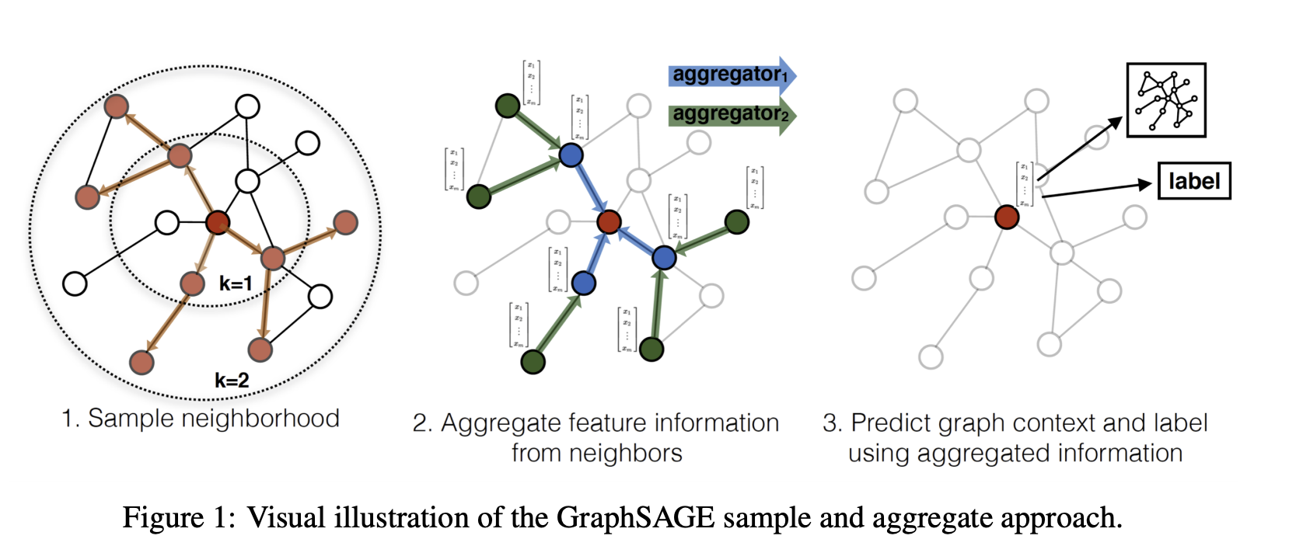
CURRENT GNN ARCHITECTURES
General GNN equation:
Ego representation
Neighbor representation
Image Source: Inductive Representation Learning on Large Graphs

Slide 14
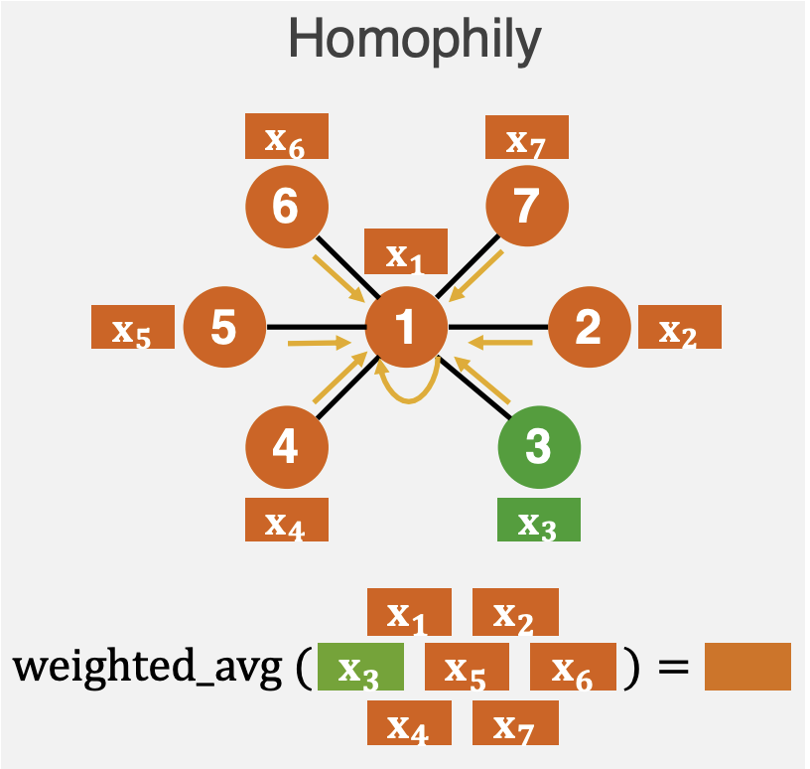
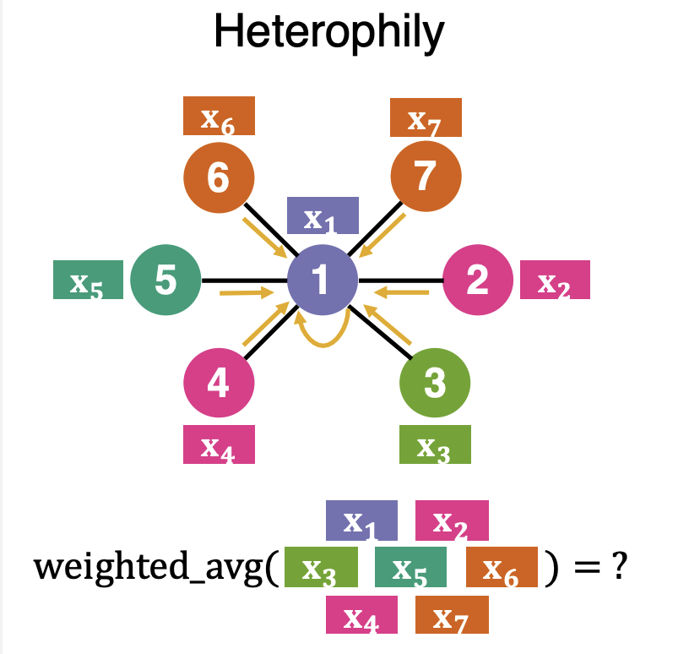
WEAKNESS
GCN – Aggregates neighbor embeddings by taking average
GAT – Aggregates neighbor embeddings by taking weighted average
GraphSAGE – Generalizes (D1)
Image source: https://www.jiongzhu.net/assets/files/F20-Jiong-H2GCN-NeurIPS-Poster.pdf

Slide 15
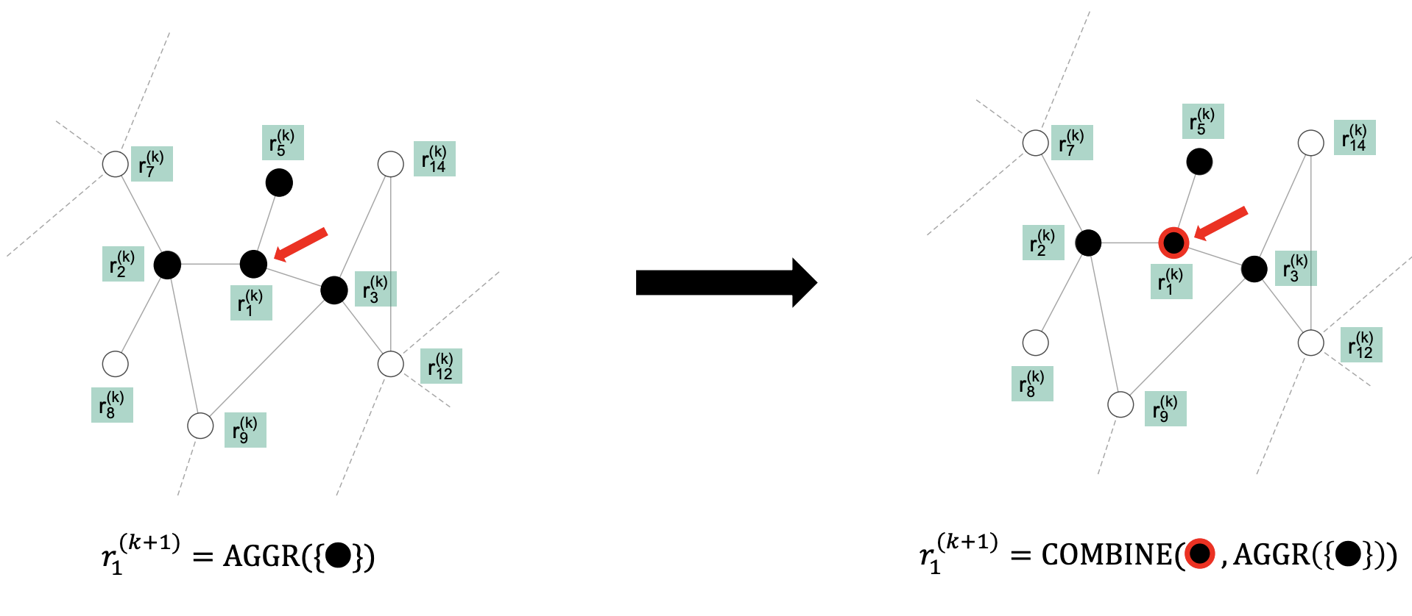
D1 : Ego- and Neighbor-embedding Separation
The ego (node) and its neighbors are likely to be dissimilar in heterophily setting
Image Source: https://www.jiongzhu.net/assets/files/F20-Jiong-H2GCN-NeurIPS-Talk.pdf

Slide 16
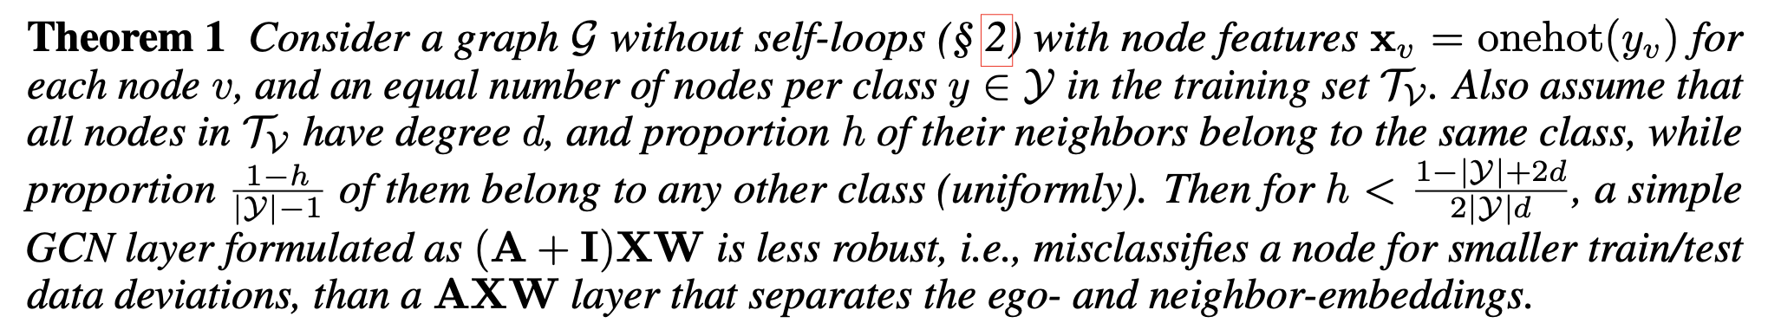
Explanation D1
To combine the ego- and the aggregated neighbor-embeddings without ‘mixing’ them : concatenate as in GraphSAGE [1], rather than averaging as in the GCN model by Kipf and Welling [2]
GraphSAGE[1] achieves 33-40% better performance in low homophily setting, as compared to GCN[2], GAT[3], and Mix-hop[4] in Table 1.
Theoretical Justification

Slide 17
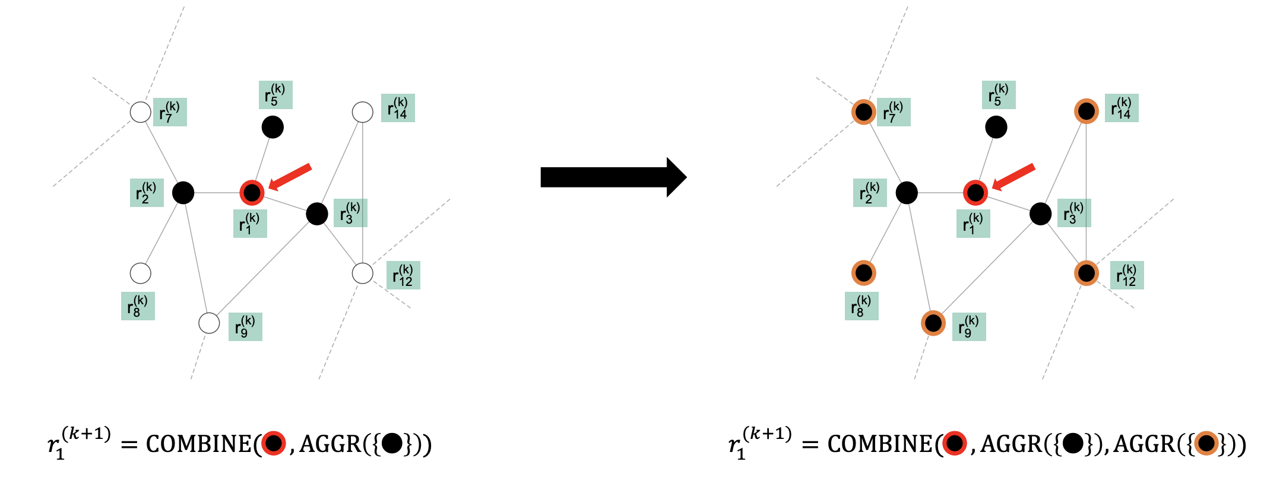
D2: Higher-order Neighborhoods
Even in heterophily, higher order neighborhoods may have similar labels as the ego (node) itself
Image Source: https://www.jiongzhu.net/assets/files/F20-Jiong-H2GCN-NeurIPS-Talk.pdf

Slide 18
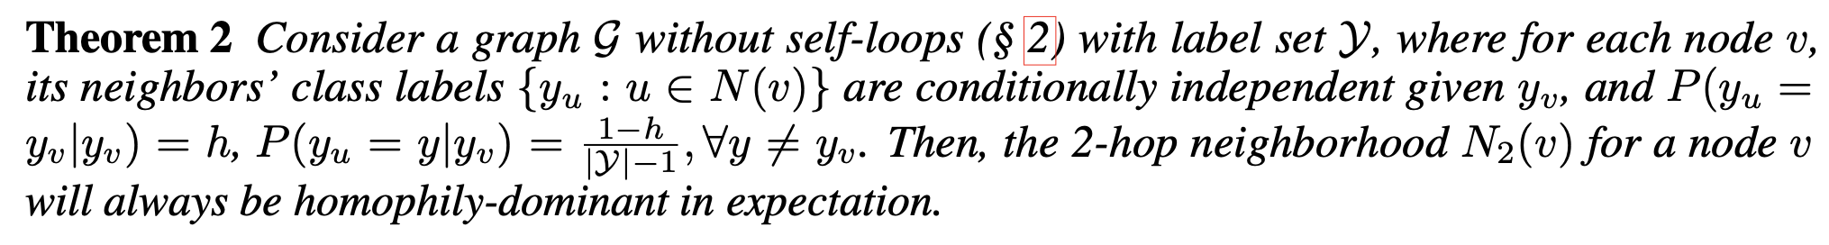
Explanation D2
Homophily-dominant neighborhoods: Beneficial for GNN layers
Heterophily-dominant neighborhoods seen empirically, immediate neighborhoods may be heterophily-dominant, but the higher-order neighborhoods may be homophily-dominant
Observations: Under heterophily (h = 0.1), GCN-Cheby[5], outperforms GCN and GAT by up to +31% (Table 1). MixHop[4], which explicitly models 1-hop and 2-hop neighbourhoods (though violating design D1), also outperforms GCN and GAT.

Slide 19
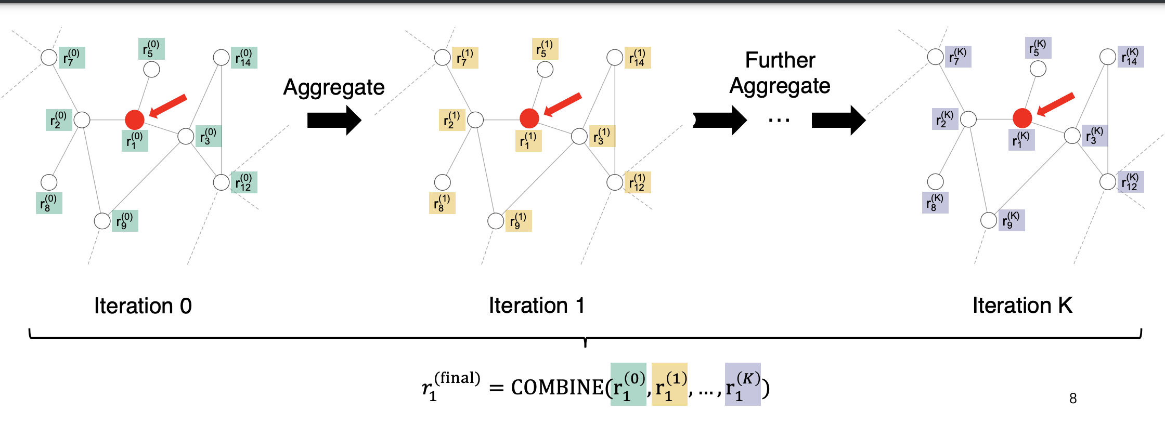
D3: Combination of Intermediate Representations
Capture local and global information via COMBINE functions
Leverage each representation separately
Image Source: https://www.jiongzhu.net/assets/files/F20-Jiong-H2GCN-NeurIPS-Talk.pdf

Slide 20
Explanation D3
COMBINE functions that leverage each representation separately:
Concatentation
LSTM – attention [6] (Xu et al, Jumping Knowledge framework)
Intuition: Each round collects information with different locality – earlier rounds are more local, later rounds capture increasingly more global information.
Observation: By using D3 with GCN, it’s accuracy increases to 58.93%±3.17 for h = 0.1, a 20% improvement over its counterpart without design D3 (Table 1).

Slide 21
Theoretical Justification: Proof given using spectral perspective, assuming GCN-style layer, where propagation can be viewed as spectral filtering.
The higher order polynomials of the normalized adjacency matrix A is a low-pass filter [7] (Wu et al, Simplifying Graph Convolutional Networks), so intermediate outputs from earlier rounds contain higher-frequency components than outputs from later rounds.
Following theorem holds for graphs with heterophily, where we view class labels as graph signals.
In heterophily settings, the label distribution contains more information at higher than lower frequencies.
By combining the intermediate outputs from different layers, this design captures both low- and high-frequency components in the final representation
Critical in heterophily settings
Allows for more expressiveness in the general setting.

Slide 22
SUMMARY OF DESIGNS
D1 models (at each layer) the ego- and neighbour-representations distinctly
D2 leverages (at each layer) representations of neighbours at different distances distinctly
D3 leverages (at the final layer) the learned ego-representations at previous layers distinctly.

Slide 23
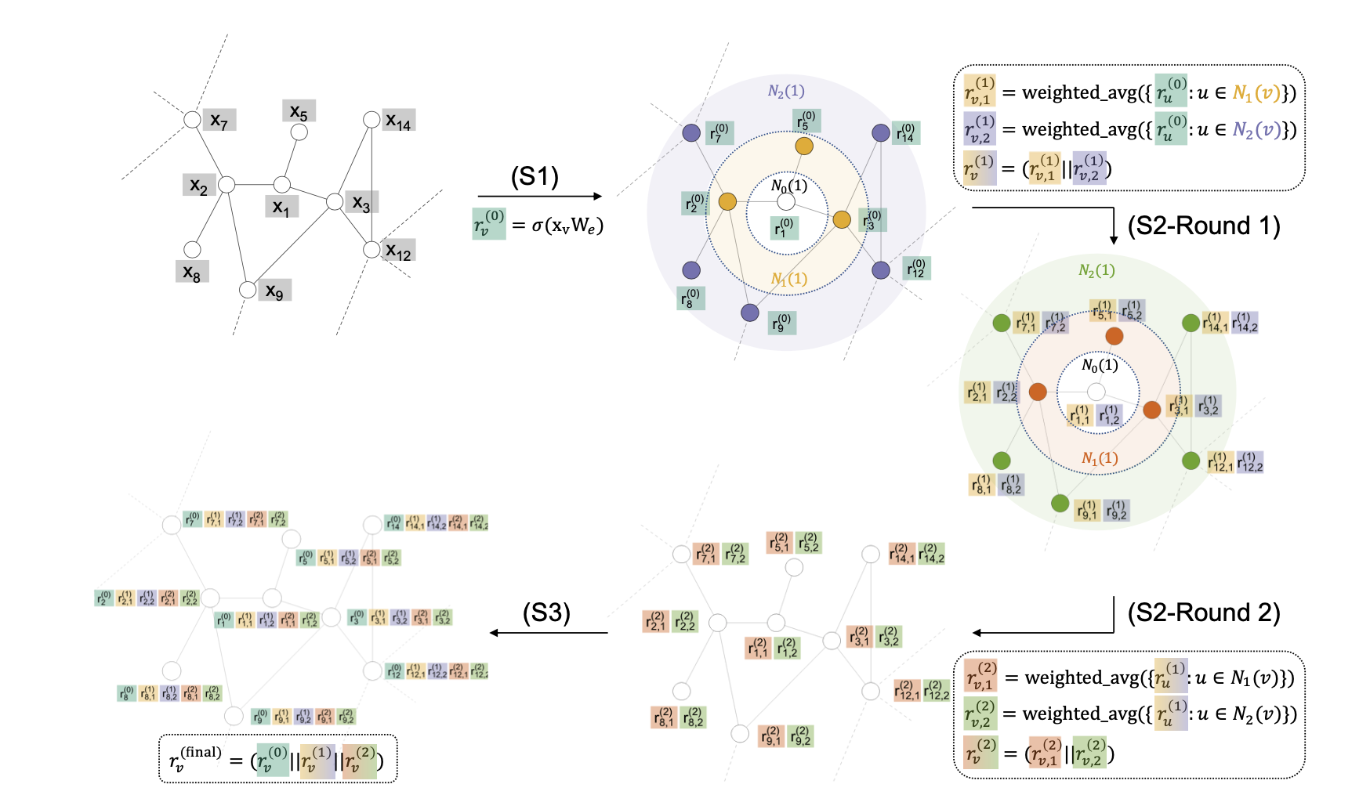
H₂GCN: A Framework for Networks with Homophily or Heterophily
S1: Feature Embedding
S2: Neighborhood Aggregation
S3: Classification

Slide 24
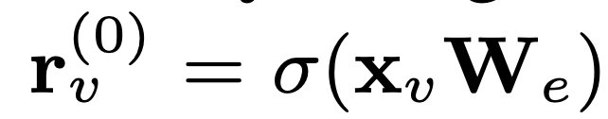
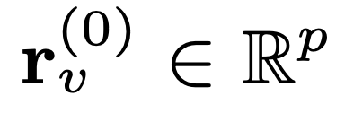
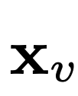
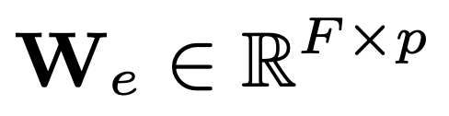
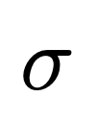
S1: FEATURE EMBEDDING
Uses a graph-agnostic dense layer to generate feature embedding for each node.
May be done to reduce size of feature embeddings since concatenation would be done in S2 and S3 stages.
: Feature embeddings for node v
: Ego- features
: Learnable weight matrix
: Non-linearity (optional)

Slide 25
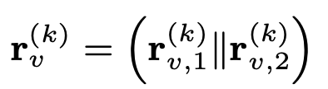
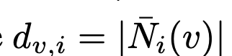
S2: NEIGHBORHOOD AGGREGATION
The generated embeddings are aggregated and repeatedly updated within node’s neighborhood for K rounds
Following D1 and D2:
: i-hop neighborhood of node v
Have not combined ego- and neighbor embeddings of node v yet.
Empirically found that removing non-linear transformations per round works better in heterophily setting as well (Done in [7] in homophily setting)

Slide 26
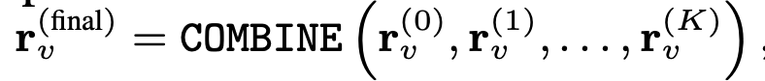
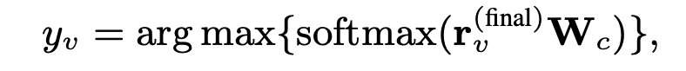
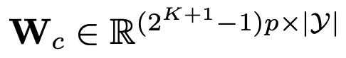
S3: CLASSIFICATION
Each node is classified based on its final embedding, which consists of its intermediate representations concatenated as per design D3.
: Learnable weight matrix

Slide 27
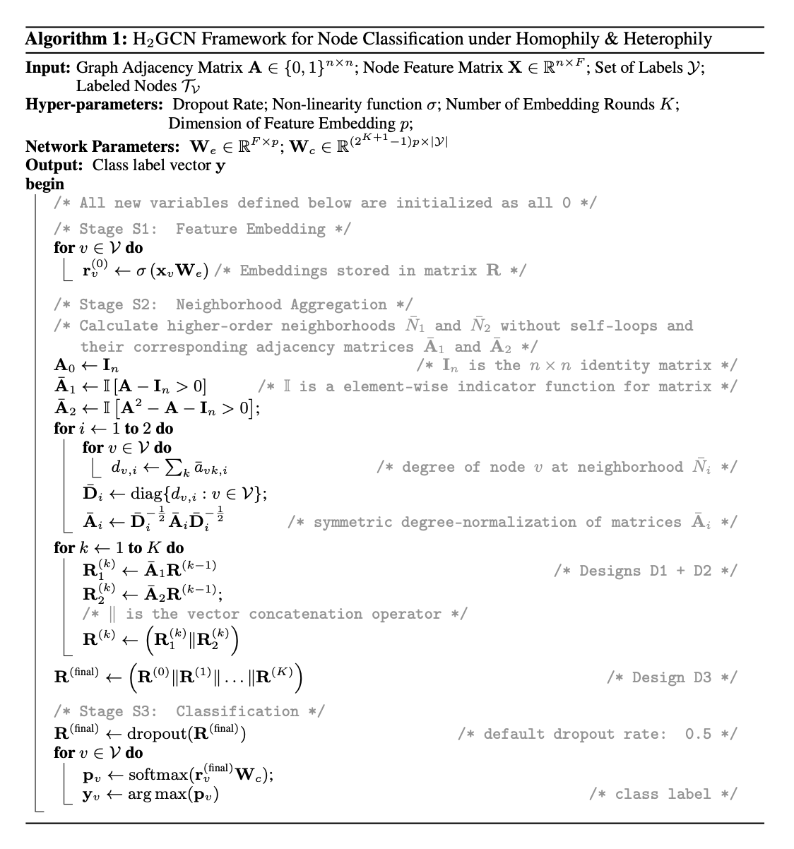

Slide 28
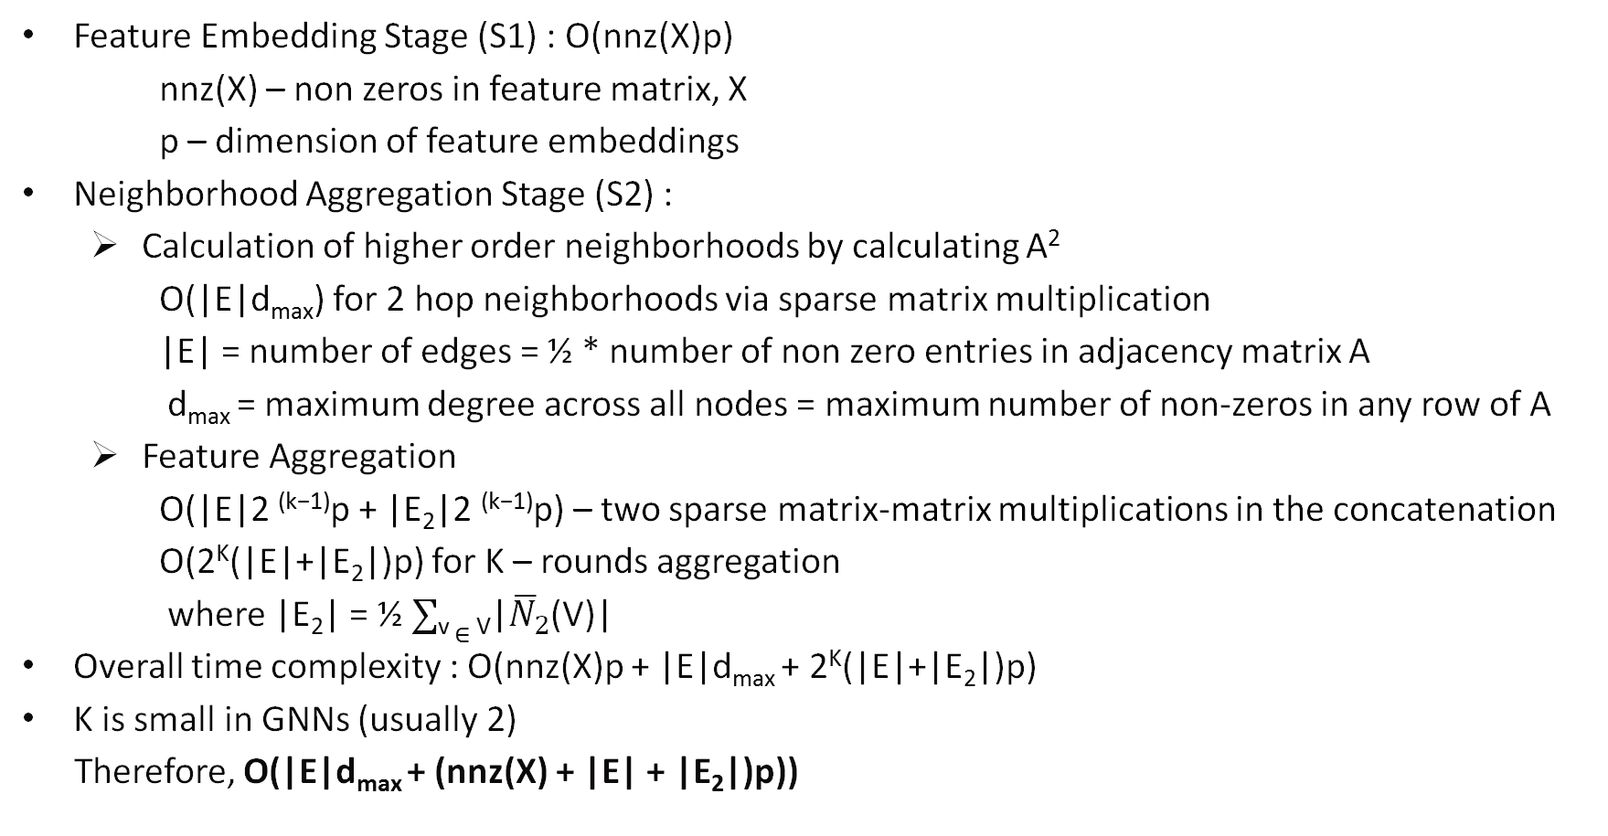
TIME COMPLEXITY ANALYSIS
Feature Embedding Stage (S1) : O(nnz(X)p)
nnz(X) – non zeros in feature matrix, X
p – dimension of feature embeddings
Neighborhood Aggregation Stage (S2) :
Calculation of higher order neighborhoods by calculating A²
O(|E|d_{max}) for 2 hop neighborhoods via sparse matrix multiplication
|E| = number of edges = ½ * number of non zero entries in adjacency matrix A
d_{max} = maximum degree across all nodes = maximum number of non-zeros in any row of A
Feature Aggregation
O(|E|2 ^{(k−1)}p + |E₂|2 ^{(k−1)}p) – two sparse matrix-matrix multiplications in the concatenation
O(2^{K}(|E|+|E₂|)p) for K – rounds aggregation
where |E₂| = ½ $∑$_{v} $∈$ _{V}|${\overline{N}}_{2}$(V)|
Overall time complexity : O(nnz(X)p + |E|d_{max} + 2^{K}(|E|+|E₂|)p)
K is small in GNNs (usually 2)
Therefore, O(|E|d_{max} + (nnz(X) + |E| + |E₂|)p))

Slide 29
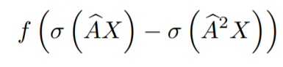
RELATED WORK
MixHop: Higher-Order Graph Convolution Architectures via Sparsified Neighborhood Mixing - Haija et al, ICML 2019
Explicitly considers higher-order neighbourhoods by mixing powers of adjacency matrix in each round. A mapping function of delta operator is learnable
Output layer uses a column-wise attention layer, while H₂GCN uses concatenation to represent high-frequency components critical in heterophily
Representation Learning on Graphs with Jumping Knowledge Networks– Xu et al, ICML 2018
JK Networks - flexibly leverages, for each node, different neighborhood ranges to enable better structure-aware representation
Jump connections and a subsequent selective but adaptive aggregation mechanism
Convolutional Neural Networks on Graphs with Fast Localized Spectral Filtering – Bresson et al, Neurips 2016
Graph Signal Processing
GCN-Cheby - localized filters parametrization with Chebyshev polynomials of order k
Geom-GCN: Geometric Graph Convolutional Networks - Pei et al, ICLR 2020
precomputes unsupervised node embeddings and uses neighborhoods defined by geometric relationships in the resulting latent continuous space to define graph convolution
Geometric deep learning – Bronstein et al, CVPR 2016

Slide 30
RELATED WORK
Diffusion Improves Graph Learning - Klicpera et al, NeurIPS 2019
Combining Spatial MPNN framework with theoretical Spectral approach
Graph Diffusion Convolution(GDC) - replaces the adjacency matrix with a sparsified version of a diffusion matrix such as Heat Kernel or personalised Page Rank.
Adaptive Universal Generalized PageRank Graph Neural Network – Chien et al, ICLR 2021
Graph Agreement Models for Semi-Supervised Learning - Stretcu et al, NeurIPS 2019
GAM - augment the classification task with an agreement task, training two models in a co-training fashion to predict whether pairs of nodes share the same label
auxiliary agreement model predicts the probability of two nodes sharing the same label as a learned function of their features

Slide 31
RELATED WORK
Graph Markov Neural Networks – Qu et al, ICML 2019
GMNN models the joint label distribution with a conditional random field,
And then trained with expectation maximization(EM) using GNN
two different GNNs, one for modeling the label dependency and another for approximating the posterior label distributions
Residual Correlation in Graph Neural Network - Jia and Benson, SIGKDD 2020
CGNN - models the correlation structure in the residuals of a regression task with a multivariate Gaussian.
can learn negative label correlations for neighbors in heterophily
Graph Neural Networks with Heterophily - Zhu et al, AAAI 2021
CPGNN – compatibility guided propagation GNN
models more complex label correlations by integrating the interpretable compatibility matrix notion from belief propagation into GNNs.
End-to-End model and able to handle data without contextual features

Slide 32
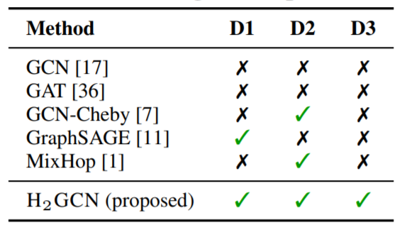
COMPARING H₂GCN WITH OTHER GNN MODELS
H₂GCN is a much simpler and powerful architecture skipping non-linear embeddings of aggregations as other models here do.
Graph agnostic feature embedding only in first stage, while keeping the JK framework for predictions.
GCN – mixes ego, neighbor representations; considers one hop neighbors, non-linear transformations in each round, no JK.
GraphSAGE – one hop neighborhood, samples fixed neighbors, non-linear transformations on concatenated representations
Table from the H₂GCN paper

Slide 33
EVALUATION SETUP
Baseline Models: Implementations from respective author repos
MLP with 1 hidden layer
GCN and GCN-Cheby
GraphSAGE
MixHop
GAT – (sparse version on large datasets)

Slide 34
H₂GCN modelled with first and second order neighbourhoods
L2 Regularization for weight matrices learning
Two Variants:
H₂GCN-1 uses one embedding round, K =1
H₂GCN-2 uses two embedding rounds, K = 2
Tuning all models on same train/validation splits
25%, 25%, 50% of nodes per class
average accuracy and standard deviation
Loss – Cross Entropy
Same hyperparameters across full spectrum of h
Best among majority of validation datasets

Slide 35
Dataset generation
Preferential attachment – scale free networks
"Emergence of scaling in random networks“ – Barabasi and Reika, Science, 1999
Preset nodes, preset class labels
All classes taken to be same size for simplicity
New node’s probability of attaching to another node is based on existing node’s degree and class compatibility matrix
Degree distribution - power law
Feature vectors are sampled from corresponding classes in real benchmark

Slide 36
Benchmark Name | syn-cora | syn-products
#Nodes |V| | 1, 490 | 10, 000
#Edges |E| | 2, 965 to 2, 968 | 59, 640 to 59, 648
#Classes |Y| | 5 | 10
#Features F | cora | ogbn-products [OGB]
Homophily h | [0, 0.1, . . . , 1] | [0, 0.1, . . . , 1]
#Graphs | 33 (3 per h) | 33 (3 per h)
Degree Range | 1 to 94 | 1 to 336
Average Degree | 3.98 | 11.93
Synthetic Datasets

Slide 37
Hyperparameters: syn-cora and syn-products
H₂GCN
features embedding dimension(p): 64
ReLU, Drop-out Rate 0 (0.5)
GCN
hidden layer dimensions: 32 (64)
epochs: 2000
GCN-Cheby
hidden layer dimensions: 64
dropout: 0.6
max_degree: 2
GraphSAGE
hidden layer dimensions: 64 (128)
learning rate: 0.7 (0.1)
epochs: 500
MixHop: hidden dimensions: 192, (0,1,2) neighbours
GAT: hidden dimensions: 8, heads: 8
MLP: feature embedding dimensions: 64, ReLU, dropout 0.5

Slide 38
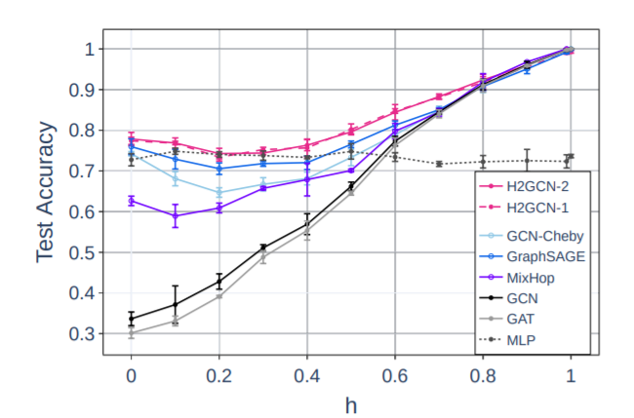
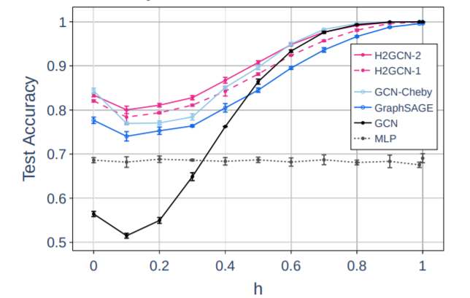
Performance on Synthetic Datasets
Syn-Cora
Syn-Products
For h<.4: Mixhop acc<.3, GAT acc <.5

Slide 39
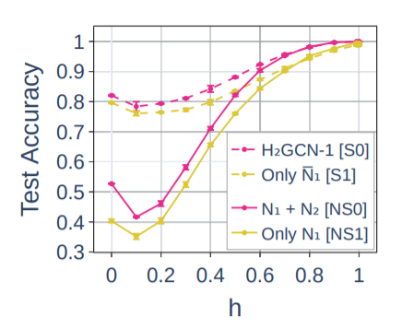
ABLATION STUDIES:
Design D1: Embedding separation
S0, S1 – separate ego and neighbourhood embeddings
NS0, NS1 – do not separate

Slide 40
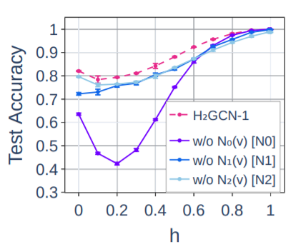
Design D2: Higher order neighbourhoods
Contribution:
Heterophily from Ego features
Homophily from Higher order neighborhoods

Slide 41
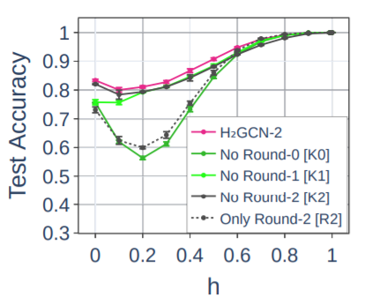
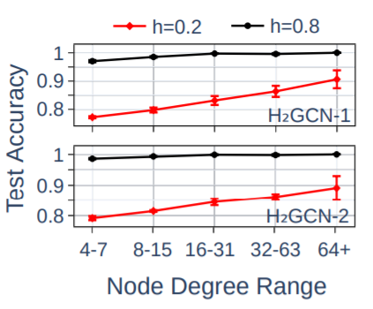
Design D3:
Intermediate representations
Accuracy per degree in hetero/homo-phily

Slide 42
REAL DATASETS
Texas, Wisconsin, Cornell – Webpages links as graphs, nodes are webpages with 5 classes: student, faculty, staff, project and course
Squirrel and Chameleon – Webpage subgraphs of Wikipedia on topics, class labels are based on average page traffic ranks
Actor – actor co-occurrence from Wikipedia

Slide 43
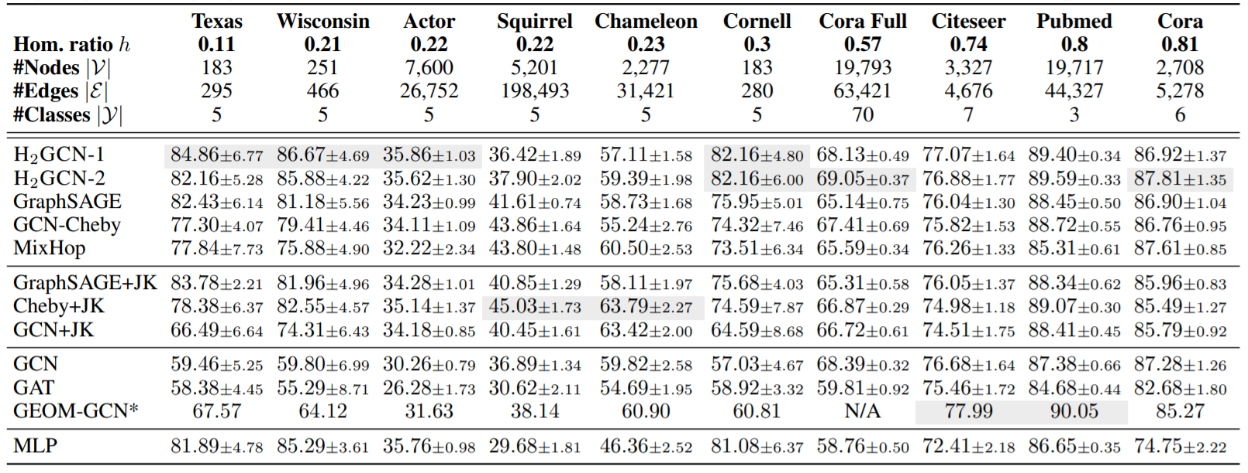
| -> Low quality <-|
node features

Slide 44
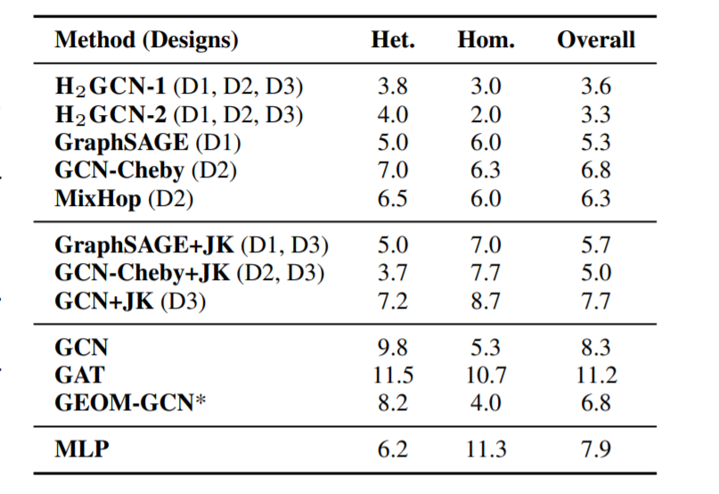
h≤ 0.3
h ≥ 0.7
Average Rank of models on Real benchmark datasets

Slide 45
Drawbacks and Extensions
Not able to scale well to large datasets
space complexity high - with Design 3 limitations of concatenating all the intermediate outputs
Full neighborhood inclusion for aggregations is also not scalable and so have to study the effect of sampling like GraphSAGE
while taking care of high variance that can be caused by second-order neighborhood
Benchmarking on other GNN tasks like link prediction, clustering
Class label imbalances can make homophily metric(h) to be misleading
Smaller size datasets

Slide 46
Two Sides of the Same Coin: Heterophily and Over-smoothing in Graph Convolutional Neural Networks, Yan et al, Feb 2021
Triggers the over-smoothing problem and are prone to be misclassified:
in shallow layers:
nodes with high heterophily and
nodes with low heterophily and low degrees relative to their neighbors
in deeper layers:
nodes with high heterophily and high degree nodes
Ideas for GGCN (generalized GCN) :
signed messages
“messages” sent by neighbors of a different class could be negated to decouple the heterophily and over-smoothing problems
Cosine similarity idea between nodes with the proxy as Feature vectors correlation
Learns a weighted combination of self features, positive messages, negative messages
degree corrections
Low degree nodes are rescaled through a learned scheme

Slide 47
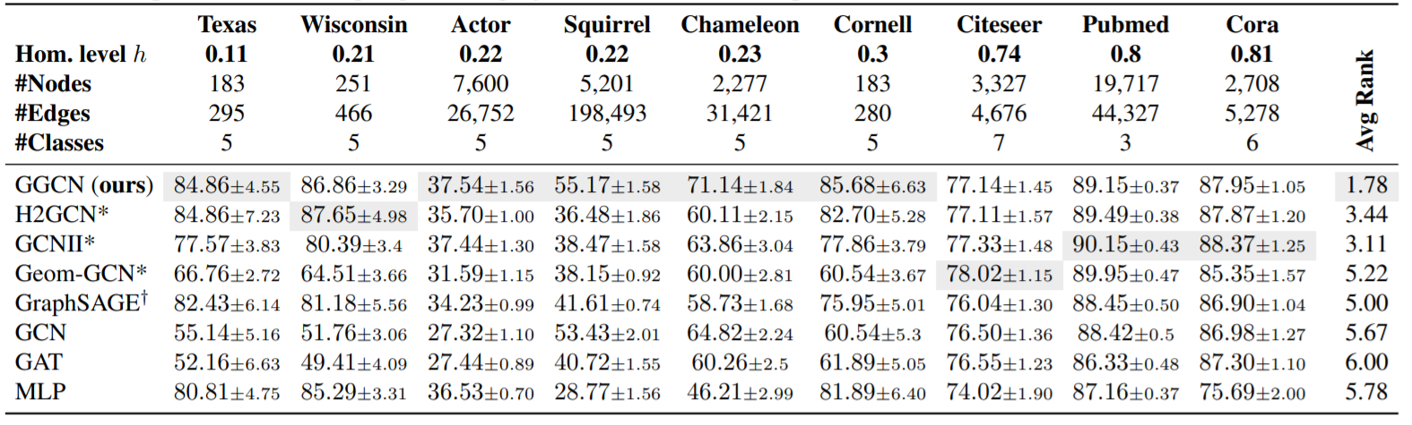
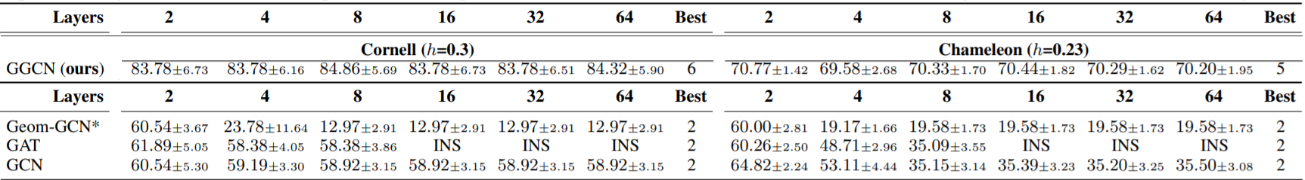

Slide 48
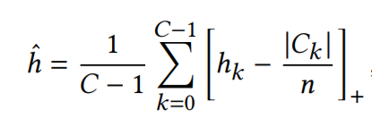
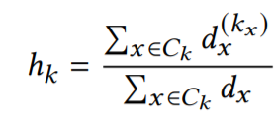
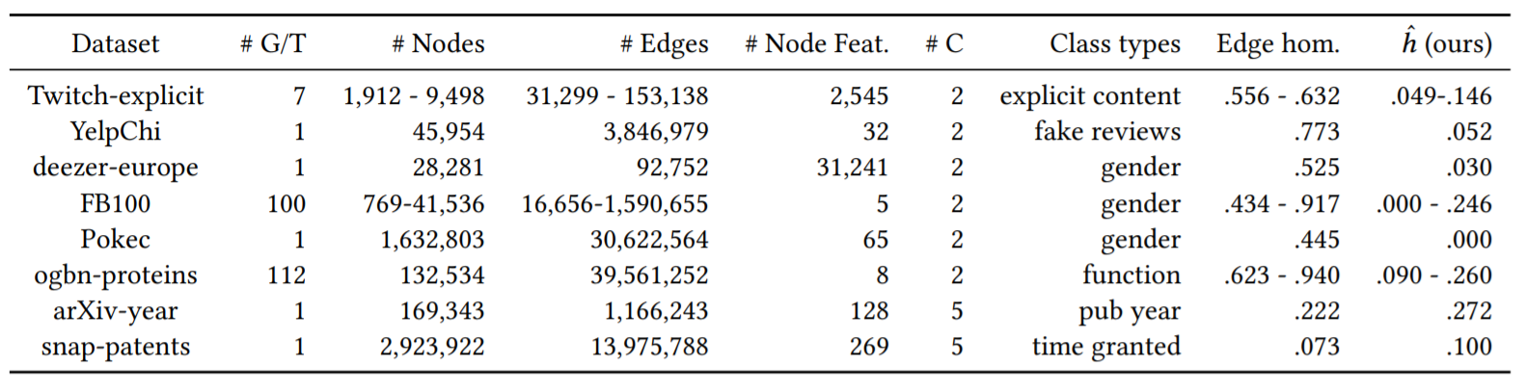
New Benchmarks for Learning on Non-Homophilous Graphs, Lim et al, WWW, Apr 2021
Where

Slide 49
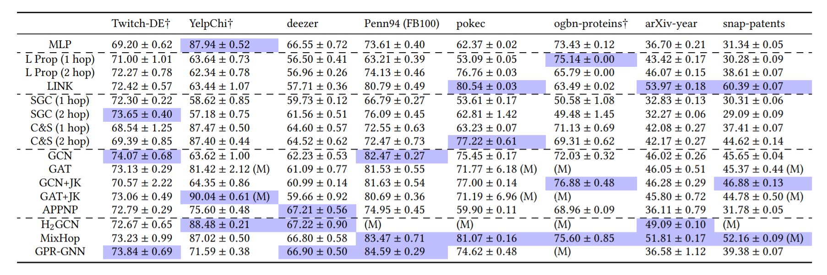
*Accuracy or ROC AUC†
Table from Lim et al, WWW, Apr 2021

Slide 50
CONCLUSIONS
Heterophily consideration is important to avoid filter bubble and real life heterophilic datasets like protein and molecular structures
Helpful for not just performance reasons but also fairness and diversity
Intuitions, Design theory and analysis of previous methods and H₂GCN model performance that improved representation power in the context of heterophily
Adapts to both heterophily and homophily
Space complexity issues of current design

Slide 51
REFERENCES
[1] Will Hamilton, Zhitao Ying, and Jure Leskovec. 2017. Inductive representation learning on large graphs. In Advances in neural information processing systems (NeurIPS). 1024–1034.
[2] Thomas N. Kipf and Max Welling. 2017. Semi-Supervised Classification with Graph Convolutional Networks. In International Conference on Learning Representations (ICLR).
[3] Petar Velickovic ́, Guillem Cucurull, Arantxa Casanova, Adriana Romero, Pietro Liò, and Yoshua Bengio. 2018. Graph Attention Networks. International Conference on Learning Representations (ICLR) (2018).
[4] SamiAbu-El-Haija, Bryan Perozzi, Amol Kapoor,Hrayr Harutyunyan, Nazanin Alipourfard, Kristina Lerman, Greg Ver Steeg, and Aram Galstyan. 2019. MixHop: Higher-Order Graph Convolution Architectures via Sparsified Neighborhood Mixing. In International Conference on Machine Learning (ICML).
[5] Michaël Defferrard, Xavier Bresson, and Pierre Vandergheynst. 2016. Convolutional neural networks on graphs with fast localized spectral filtering. In Advances in Neural Information Processing Systems (NeurIPS). 3844–3852.

Slide 52
[6] Keyulu Xu, Chengtao Li, Yonglong Tian, Tomohiro Sonobe, Ken-ichi Kawarabayashi, and Stefanie Jegelka. 2018. Representation Learning on Graphs with Jumping Knowledge Networks. In Proceedings of the 35th International Conference on Machine Learning, ICML, Vol. 80. PMLR, 5449–5458.
[7] Felix Wu, Amauri Souza, Tianyi Zhang, Christopher Fifty, Tao Yu, and Kilian Weinberger. 2019. Simplifying Graph Convolutional Networks. In International Conference on Machine Learning (ICML). 6861–6871.

